Slide 1

Alligators Test Plan
FP 5
gd3451er@go.minnstate.edu
sapana.kunwar@my.metrostate.edu
tenzin.nangsel@go.minnstate.edu
jx3563ek@go.minnstate.edu
Xf1675pp@go.minnstate.edu

Slide 2
Test case id: 1
Test case title: Creation of movies, songs, and movie_song.
Description: In this program will run to check if native_name and year_made are already existed in the movie and title from the song table to ms_test_data table. If it doesn’t exist, it will be added to movies and songs table. Then it checks the movie_id from the movie table whether it already exit in the movie_song table and if it doesn’t exist, it will insert of movie_id that corresponded with the song_id in the movie_song table.
Test case data:
Insert movies from ms_test_data to all 3 tables.
Expected results:
[1] The last column should be updated with M created S created MS created.
[2] All new movies are created in movies table.
[3] All new songs are created in songs table.
[4] All new movie_ids with song_ids are created in movie songs table.

Slide 3
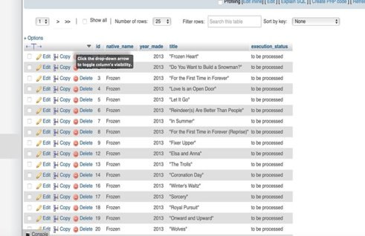
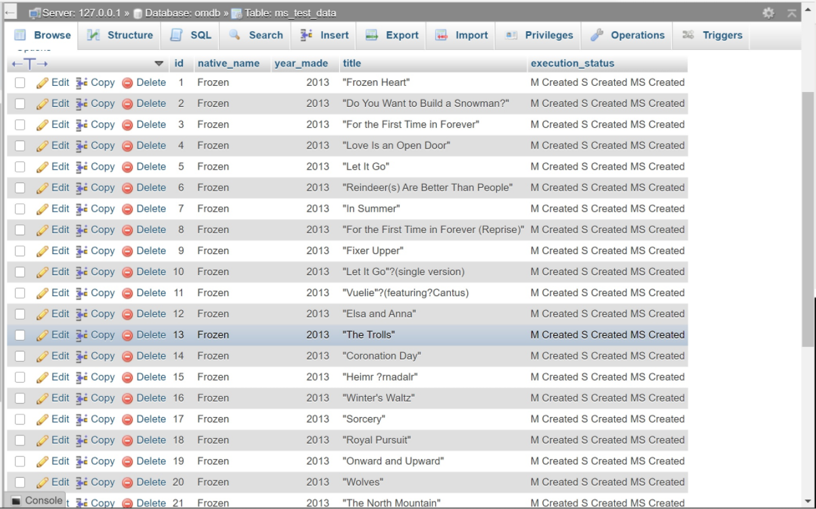
Before
After
Actual Results: [X]Passing [ ] Failing

Slide 4
Test case id: 2
Test case title: Creation of movie, song, and ignore movie_song (C C I)
Description: This program will run to check if native_name and year_made are already existed in the movie and title from the song table to ms_test_data table. If it doesn’t exist, it will be added to movies table, songs table. Then it checks the movie_id from the movie table whether it already exit in the movie_song table and it will ignore the insertion of movie_id that corresponded with the song_id in the movie_song table.
Test case data:
Insert movies from ms_test_data to movie table and songs table.
Expected results:
[1] The last column should be updated with M created S created MS ignored.
[2] All new movies are created in movies table.
[3] All new songs are created in songs table.
[4] Existing movie_id with songs are ignored inserting in the movie_song table.

Slide 5
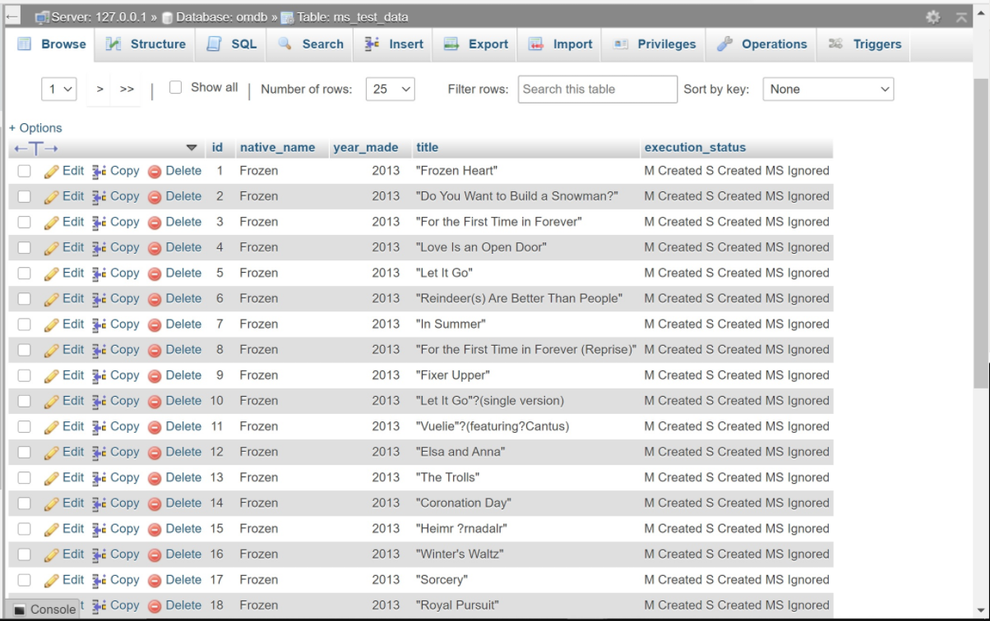
Before
After
Actual Results: [X]Passing [ ] Failing

Slide 6
Test case id: 3
Test case title: Creation of movie, ignore song, and ignore movie_song (C I I)
Description: This program will run to check if native_name and year_made are already existed in the movie and title from the song table from ms_test_data table. If it doesn’t exist, it will be added to movies table. All the existing title of the song from ms_test_data table will be ignored inserting in the songs table. Then it checks the movie_id from the movie table whether it already exit in the movie_song table and it will ignore the insertion of movie_id that corresponded with the song_id in the movie_song table.
Test case data:
Insert movies from ms_test_data to movie_table and songs_table.
Expected results:
[1] The last column should be updated with M created S ignored MS ignored.
[2] All new movies are created in movies table.
[3] Existing song titles will be ignored inserting in the songs table.
[4] Existing movie_id with songs are ignored inserting in the movie_song table.

Slide 7
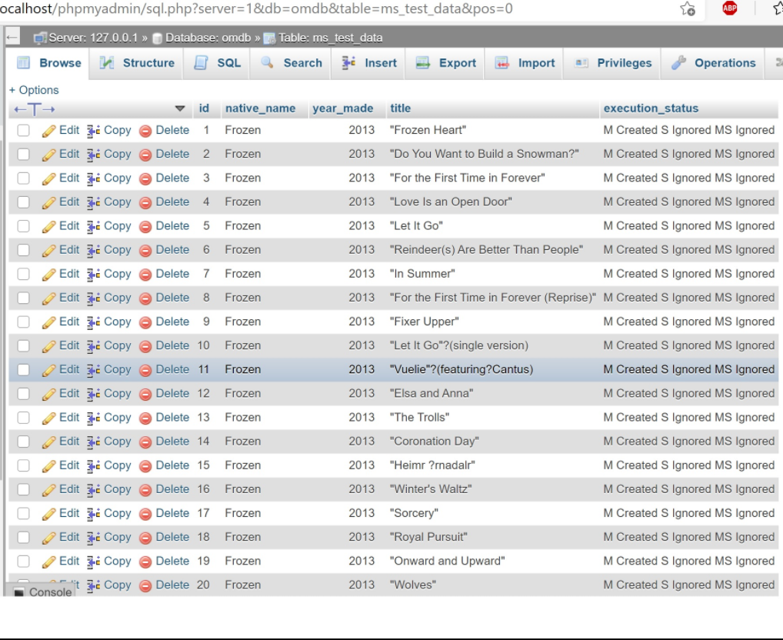
Before
After
Actual Results: [X]Passing [ ] Failing

Slide 8
Test case id: 4
Test case title: Ignore movie, ignore song, and ignore moviesong (I I I).
Description: This program will run to check if native_name and year_made are already existed in the movie and title from the song table from ms_test_data table. If it exist, it will be ignored inserting into the movies table and existing title of the song from ms_test_data table will be ignored inserting in the songs table. Then it checks the movie_id from the movie table whether it already exit in the movie_song table and it will ignore the insertion of movie_id that corresponded with the song_id in the movie_song table.
Test case data:
nothing from ms_test_data will be created because they already exist.
Expected results:
[1] The last column should be updated with M ignored S ignored MS ignored.
[2] Ignore existing movies with same native_name and year_made into the movies table.
[3] Ignore existing songs with same title into the songs table.
[4] Existing movie_id with songs are ignored inserting in the movie_song table.

Slide 9
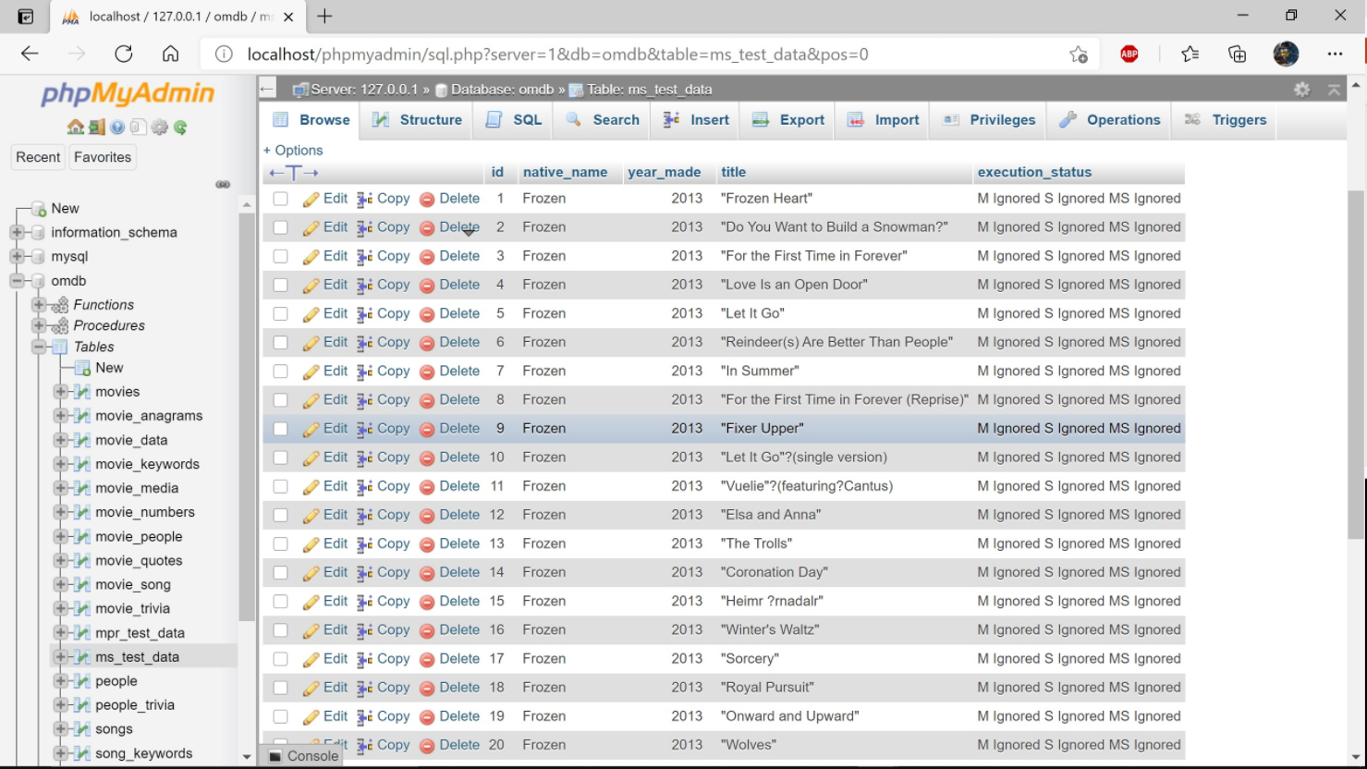
Before
After
Actual Results: [X]Passing [ ] Failing

Slide 10
Test case id:5
Test case title: Creation of movie, Ignore songs, and Creation of movie_song (C I C)
Description: This program will run to check if native_name and year_made are already existed in the movie and title from the song table from ms_test_data table. If it doesn’t exist, it will be added to movies table. All the existing title of the song from ms_test_data table will be ignored inserting in the songs table. Then it checks the movie_id from the movie table whether it already exit in the movie_song table and if it doesn’t exist, it will insert of movie_id that corresponded with the song_id in the movie_song table.
Test case data: Insert movies from ms_test_data to all 3 tables.
Expected results:
[1] The last column should be updated with M created S ignored MS Created .
[2] All new movies are created in movies table.
[4] Ignore existing songs with same title into the songs table.
[4] All new movie_ids with song_ids are created in movie songs table.

Slide 11
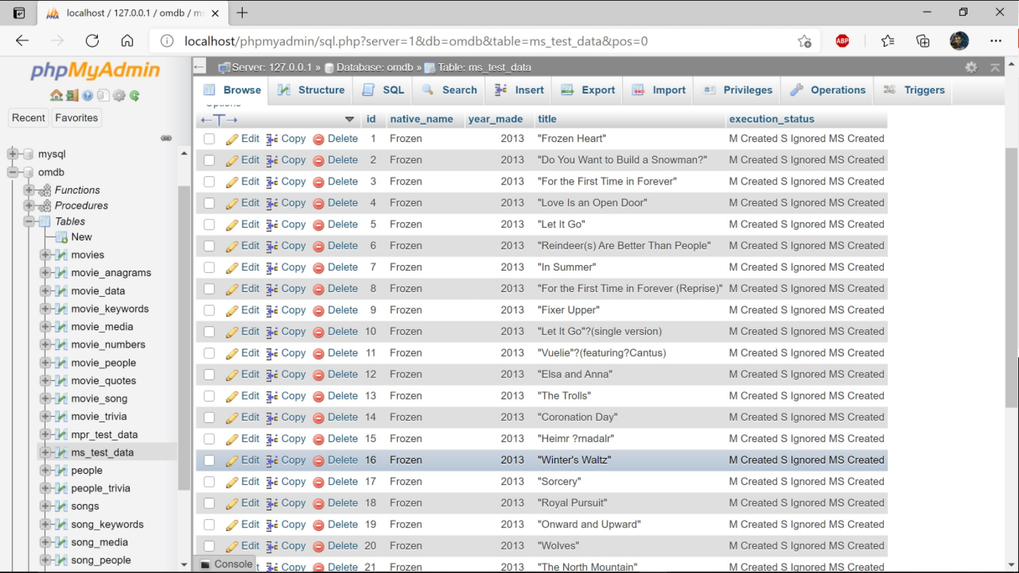
Before
After
Actual Results: [X]Passing [ ] Failing

Slide 12
Test case id: 6
Test case title: Ignore movie, Ignore song, and create movie_song (I I C)
Description: This program will run to check if native_name and year_made are already existed in the movie and title from the song table from ms_test_data table. If it exist, it will be ignored inserting into the movies table and existing title of the song from ms_test_data table will be ignored inserting in the songs table. Then it checks the movie_id from the movie table whether it already exit in the movie_song table and if it doesn’t exist, it will insert of movie_id that corresponded with the song_id in the movie_song table.
Test case data:
Insert movie_id and song_id to movie_song, ignoring movies and songs because they exist already.
Expected results:
[1] The last column should be updated with M Ignored S Ignored MS created.
[2] Ignore existing movies for songs table.
[3] Ignore existing songs for songs table.
[4] All new movie_ids with song_ids are created in movie songs table.

Slide 13
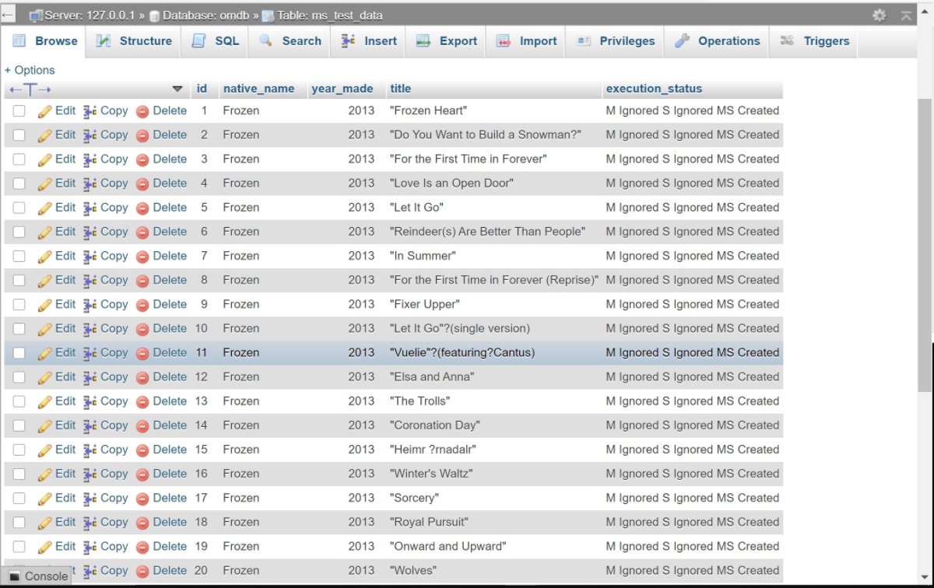
Before
After
Actual Results: [ ]Passing [ ] Failing

